Slide 1


ET 4047
M. Athallah Rizki Putra
Hafizh Mulya Harjono
M. Hanif Naufal Eka W.
Desember 2020
Depression Detection in Tweets Using TF-IDF and BOW

Slide 2
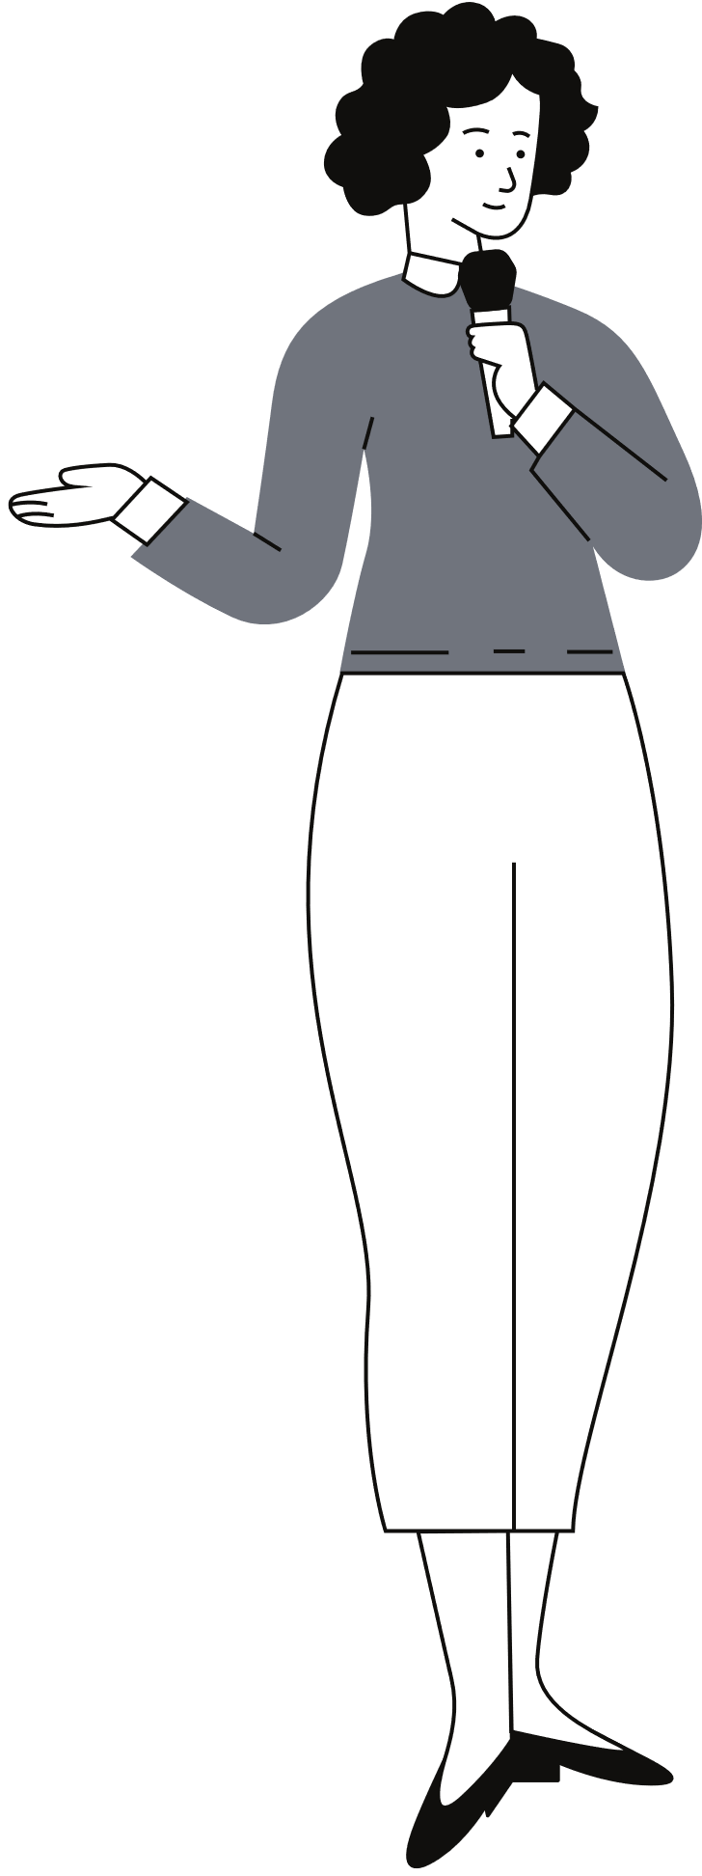
ET 4047
Desember 2020
1
Introduction
Today's
Agenda
2
Methodology
3
Results and Discussion
4
Conclusion

Slide 3


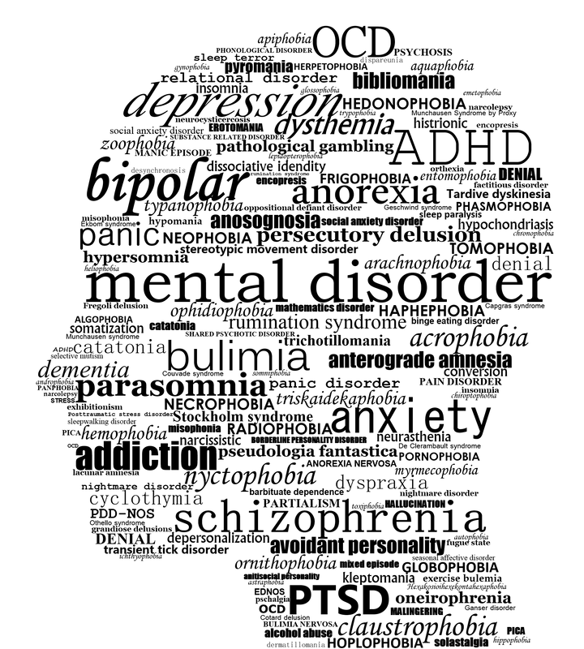
ET 4047
Desember 2020
Introduction
Depression is a common mental disorder and one of the main causes of disability worldwide
Globally, there are about 450 million people who are affected by depression
Depression
Mental Disorder

Slide 4
Depression must be detected first
Before they receive treatment
Many patients do not receive an earlier depression diagnosis in consultation with general practitioners, with roughly 50% of the cases detected

Slide 5

Machine Learning Approach is Used
To detect depression by analyzing the social media posts of users
Twitter posts have been considered to convey the model
To analyze the collective data from Twitter, TF-IDF and BOW classifier techniques are used here

Slide 6

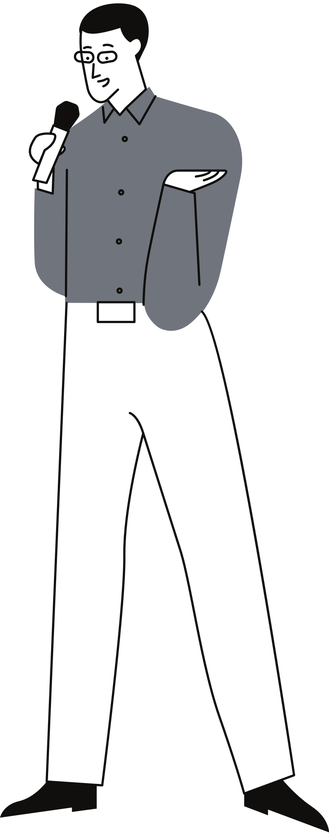


ET 4047
Desember 2020
Are you ready?
Methodology

Slide 7
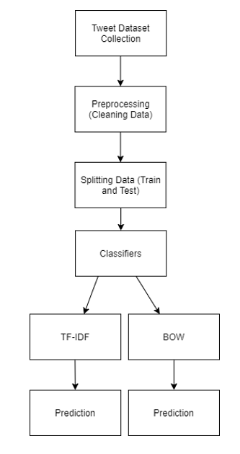
ET 4047
Desember 2020
Workflow
The workflow starts with a data collection step for the generation of datasets. Following the collection of datasets, the data is preprocessed through tokenization, stemming, and stop word removal. After this, the text classifier is trained. Last, the prediction is done by entering some texts to see the result

Slide 8
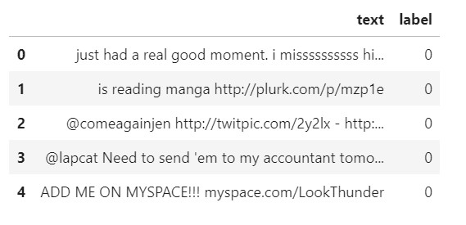
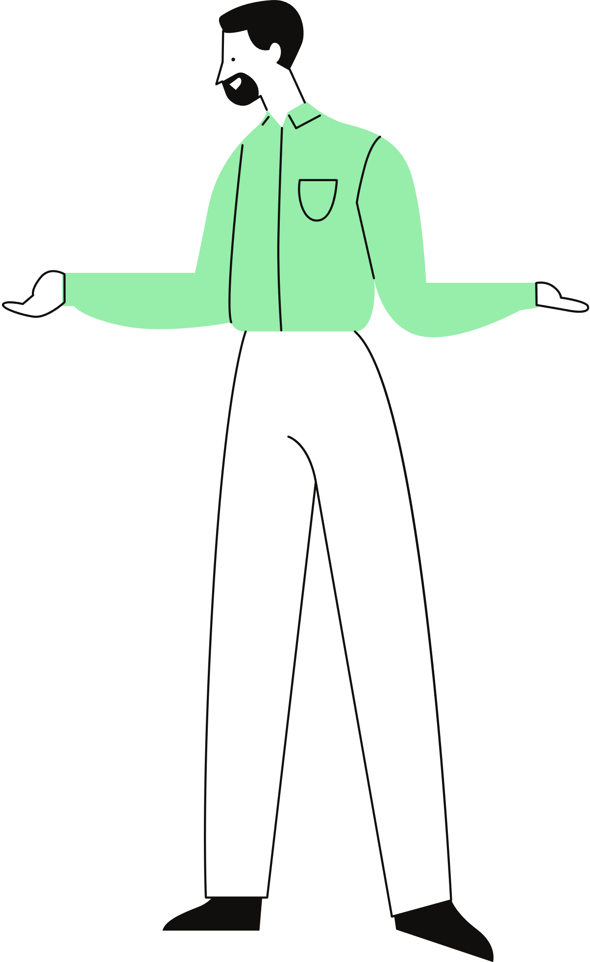
Dataset Collection
8000 depressive labelled tweets from Kaggle.
2314 tweets scrapped from GetOldTweets3, manually labelled.
Label:
“0”: non-depressive
"1": depressive
Time: 5 minutes

Slide 9

Preprocessing
Preprocessing is done through Tokenization, Stop Words Removal,
Stemming, and 2-gram mapping
Time: 5 minutes

Slide 10

ET 4047
Desember 2020
Data Splitting
Because of the small size of dataset, almost all (98%) data were allocated as training data to prevent overfitting and low accuracy in the result.
The ratio is choosen as it gives the best performace parameters, empirically
Train
Test

Slide 11


Classifiers
TF-IDF
BOW
Often used in information retrieval and text mining.
This weight is a statistical measure used to evaluate how important a word is to a document in a collection or corpus.
A text in a sentence or document is represented as a multiset bag of words contained in it
Bow maintain no information about order of word and grammar
Still maintains its diversity

Slide 12
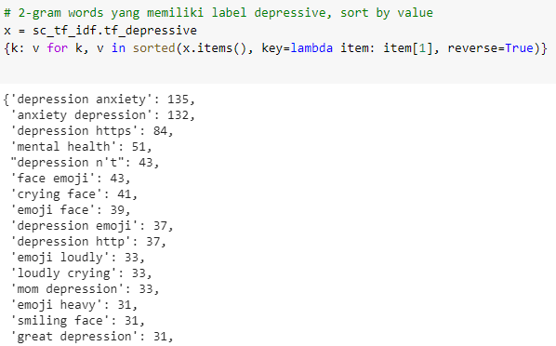
TF-IDF Weight

Slide 13
ET 4047
Desember 2020
Prediction
Author put some tweets or sentences in the predictor of two classifiers. Depressive tweets and non-depressive tweets were tested to see the prediction results.

Slide 14
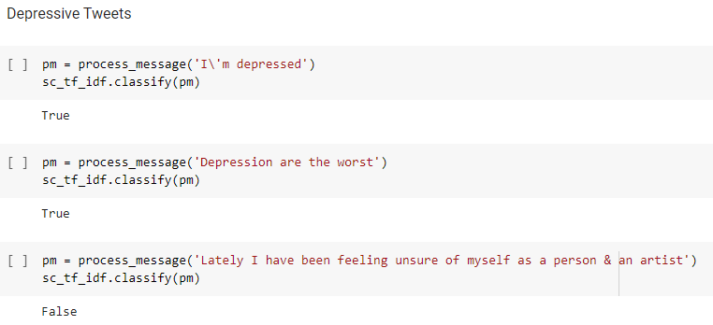

Result
False Negative

Slide 15
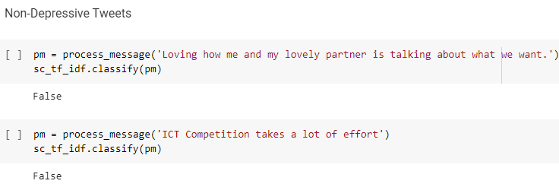
Result

Slide 16
Performance parameters
Accuracy, precision, recall, F-score
Confusion matrix
Time: 5 minutes

Slide 17
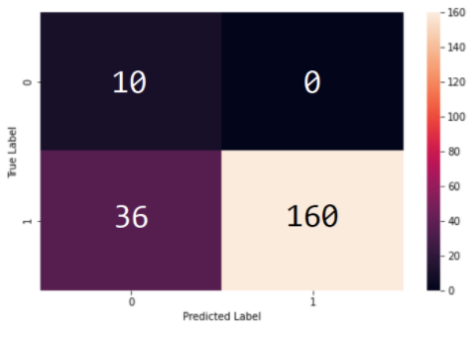
Confusion Matrix
TN
FP
N
FN means that some depressive tweets are not detected
FN
TP
P
N
P

Slide 18
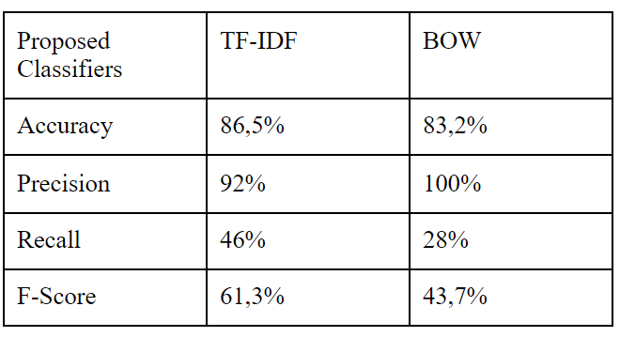

A-P-R-Fs
A = (TP+TN)/(All)
P = (TP)/(TP+FP)
R = (TP)/(TP+FN)
F = 2PR/(P+R)
F = [0, 1]

Slide 19
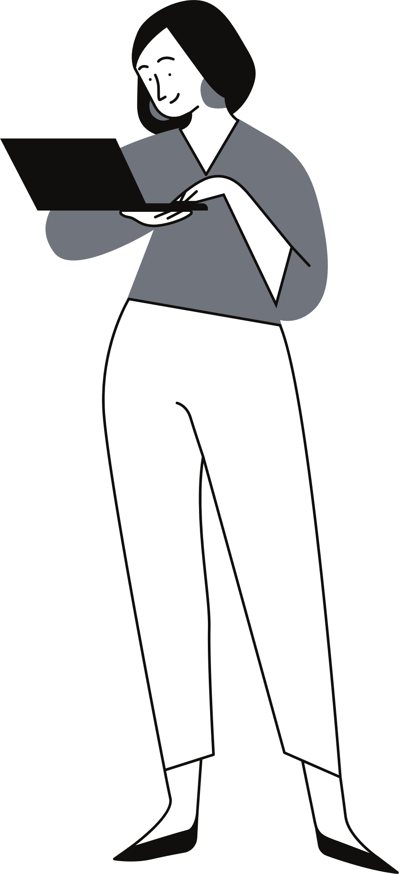
ET 4047
Conclusion
The Model has succeed to analyze tweets whether they contain depression meaning or not

Slide 20
ET 4047
Conclusion
TF-IDF model has 86,5% accuracy and 61,3% F-Score. Bow model has 83,2% accuracy and 43,7% F-Score

Slide 21
ET 4047
Conclusion
The Model can be improved by using better dataset and improved algorithm

Slide 22
Thank you for participating. Don't forget about your mental health!
We're done!

